Slide 1

Intelligent Picking
Team Name :
Institute Name:
PhyXiX
National Institute of Technology (NIT), Calicut

Slide 2

Team members details
Team Name | PhyXIX
Institute Name | National Institute of Technology Calicut
Team Members > | 1 (Leader) | 2 | 3 | 4 | 5
Name | Suryasaradhi .B | Mullai Vaneshwar | Thomas Savio | Tarun Sharma | C.R. Vivroshan
Batch | 2018 | 2018 | 2018 | 2018 | 2018
Area of expertise | Computer Vision and Processing | Mathematics and Kinematics | Model Visualisation | Python Research | Model Visualisation

Slide 3
Functionalities of the Robot
The main purpose of any robot is helping is better utilization of human resources by taking care of repetitive tasks, our robot does a great job on that front by trans-locating materials round the clock which is a tedious task otherwise for humans.
It identifies objects in real world by comparing with its database. Based on this the objects are classified and sorted accordingly in its drop location.
Robot Localization and Mapping ,Translocation , Identification , Systemization and Execution of plan paths describes the activities of the robot in its entirety.
The hybrid system of suction grabbing and mechanical grabbing ensures that most, if not all objects are in the scope of the robot. The intrinsic properties of the robot ensures that it can even work in pitch dark warehouses even in absence of light. These two features makes this machinery better by leaps and bounds compared to others.
Another desirable feature that comes along with robot, is the mounting of the frame, that holds the grabber and its path, to translocate objects both horizontally and vertically while being in-concurrent.

Slide 4
Robot Specifications
Overall:
Total Weight : ~10kg
Total Power Draw : ~100W
Optimal Supply Voltage : ~240V
Max Supply Current : ~10A
Product Dimensions : 6m x 3m x 2m
Maximum Load Transportable : ~5KG
Minimum Pick-to-Drop Time : ~30s
Gripper :
Surface Grip : Silicon Tips * 2
Jaw Style : Baxter Jaws
Suction style: Suction Cup 2cm x 2cm
Motors :
Control Signal : PWM Analog
Torque : @ 4.8V: 12.2 kg-cm @ 6.0V: 14.5 kg-cm
Speed : @ 4.8V: 0.20 sec/60° @ 6.0V: 0.18 sec/60°
Controllers :
Onboard controller Type : PWM
Voltage : 3~5 V
Architecture : Microcontroller
Third party devices such as KINECT will be used to generate imageries.
A GPU-Powered Cloud Cluster will be used for calculations received from the robot.

Slide 5
Robot/Solution Limitations
The Robot runs from the data provided by KINECT, so all defects of the device will be shared with the robot’s Limitations
The Robot uses Deep Learning which requires time to compute even on modern GPUs.
The accuracy of Grasps varies with object to object. The robot can't grasp cloth like soft(Non-rigid) materials and completely transparent objects.
Works Best when placed horizontal, although it can be mounted on walls but performance will decrease when it is mounted vertically.
Is not able to predict contact forces and the strength used to grip the object, thus object may fall off while on transport.
Limited range to carry objects but can be improved as per demanded.
The robot has only 1 degree of freedom if the robot is not able to grab the object through both the methods, it will leave the object without anymore attempts.
The robot can only pick up objects which are inside a certain volume range depending on the gripper’s specifications.

Slide 6
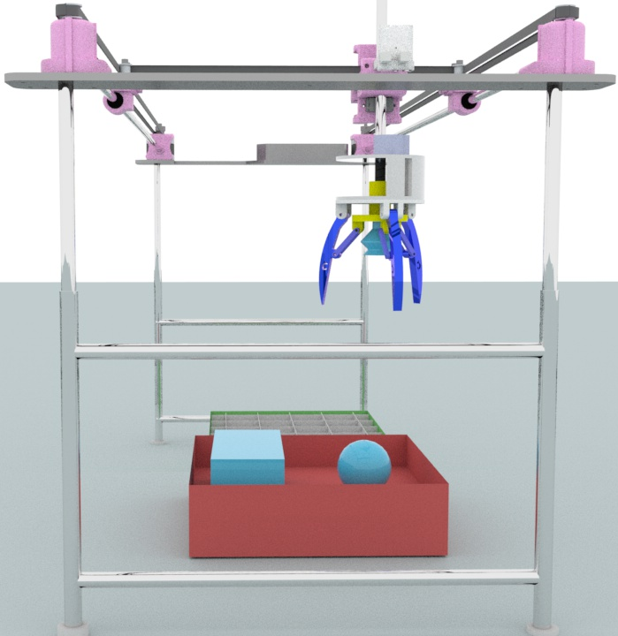
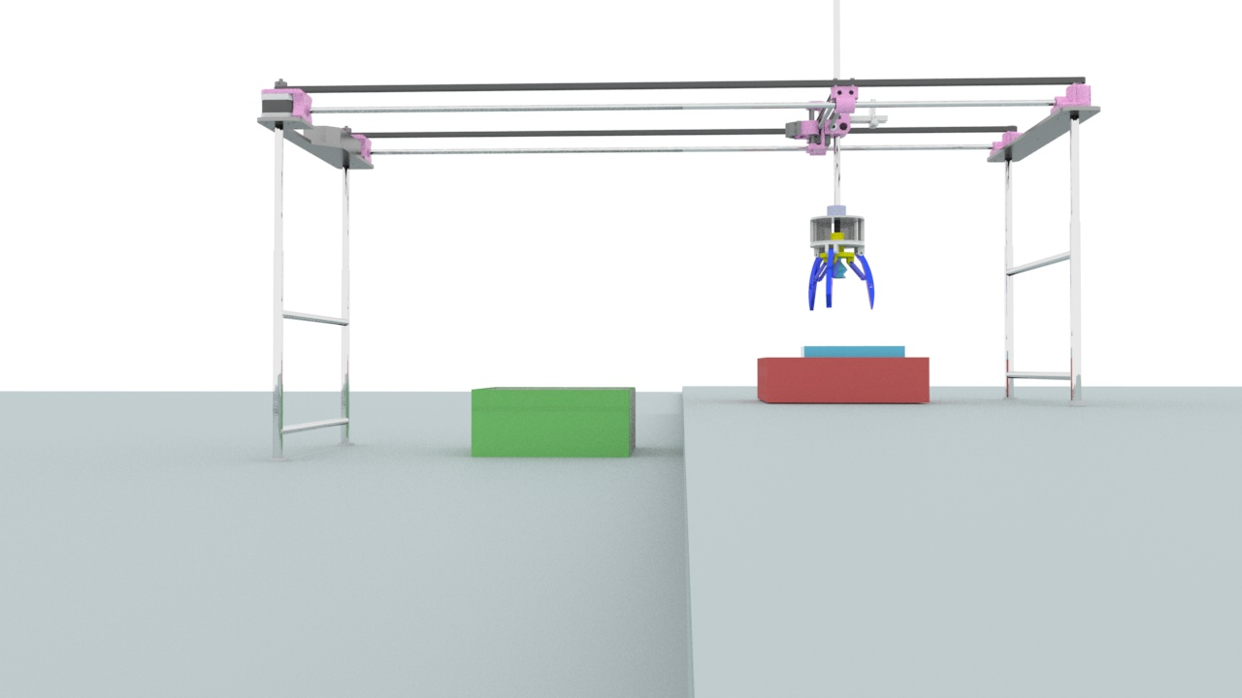
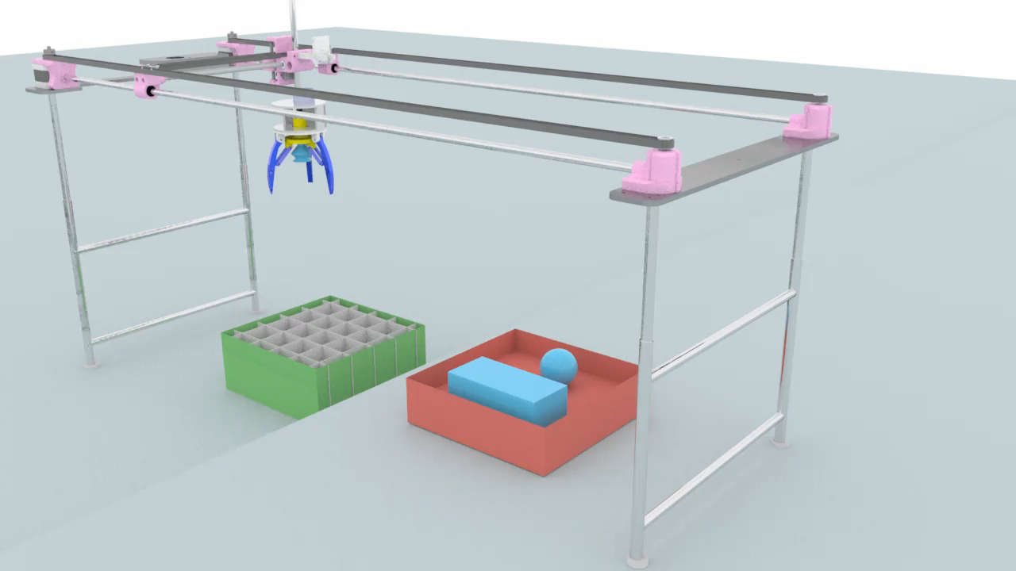
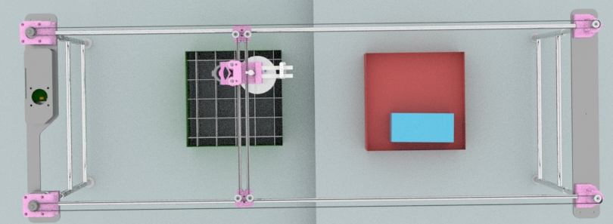
Robot Visualization -3D Diagram/Sketch
DOWNLOAD SIMULATED
MODEL HERE:
WORKING VIDEO CLICK TO PLAY:

Slide 7
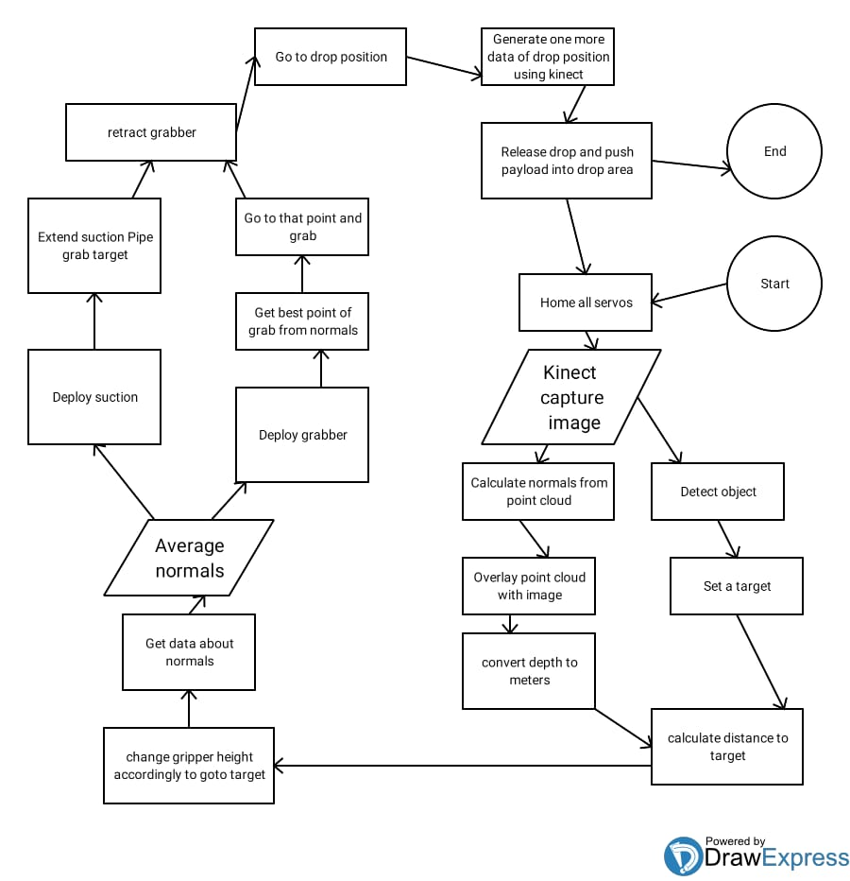
Architecture
The Robot uses an Arduino mega for bi-directional communication with a PC where major calculations will be done.
2x NVIDIA GPU’s with a Cloud based GPU farm will be used for fast deep learning processing.
An Xbox Kinect will be used for getting depth info of the scene.
The robot has two reed switches and a infrared depth sensor to determine the homing position of the grasper.
System architecture flowchart

Slide 8
Brief on Programming Module
Software and Packages Used
Python 3.7 and C will be used in the Ubuntu and Windows. For faster computation codes are written in CUDA and compiled to Cubin and then get executed in the GPU itself. For coding Arduino C++ will be used and AutoIt will serve as the front end to receive signals on the PC side on windows. All programs that are need to be flashed to hardware will be written into packages to make them more portable. ROS packages mainly GrabIT! is converted to native python so as to make it more flexible while programming.
Tensorflow will be primarily used for Deep learning purposes. A dataset for feature extraction will be trained. Kinect will be used to extract 3-D data of the world. For finding depth using data from Kinect, OpenCV-python will be used. Kinect belongs to a class of depth sensors which are compatible with OpenNI. OpenNI supports sensors through VideoCapture class, Depth map, BGR image and other form of outputs can be retrieved using interface of VideoCapture. We have to configure OpenCV with OpenNI by setting WITH_OPENNI flag in CMake. PrimeSensor module is used to grab data from kinect. We will be Using Argparse library for parsing customised arguments in our program. Libfreenect and OpenNI are used as framework for Kinect which enables us to get a RGBD map of the world which is supplied to a neural network for analysis.
Approach for Real world mapping
RTAB-Map is a RGB-D Graph-Based SLAM approach based on an additive appearance-based loop closure detector. Loop closure detection is essential for the mapping process as it determines map completion and also allows the bot to localize itself. The underlying structure of the map is essentially a graph which consists of nodes and links.

Slide 9
Modules used (deployed)
Image Classifier
TFLearn – Deep learning library featuring a higher-level API for TensorFlow used to create layers of our CNN
tqdm – Instantly make your loops show a smart progress meter, just for simple designing sake
Numpy – To process the image matrices
OpenCV – To process the image like converting them to grayscale and etc.
os – To access the file system to read the image from the train and test directory from our machines
random – To shuffle the data to overcome the biasing
matplotlib – To display the result of our predictive outcome.
tensorflow – Just to use the tensorboard to compare the loss and adam curve our result data or obtained log.
Kinect Framework
OpenNI - Kinect interaction with OpenCV support
Libfreenect – More faster direct Kinect interaction but in C with more functions.
Languages Used
Python – Core Interface in mathematical computing at computer side
C – To program the hardware as well as to extract data using libfreenect
C# – Implement a GUI for the robot
C++ – Programing hardware
AutoIt – Used at host for serial communication with hardware faster.
Code samples: Image Classification , Kinect pointcloud

Slide 10
Execution Plan
High level action items in terms of what will be the steps from the drawing board to the actual prototype.

Slide 11
<<Extra: Slide#10>>

Slide 12
